Slide 1
Problem Statement Worksheet (Hypothesis Formation)
By refining the ticket pricing strategy and identifying operational efficiencies at Big Mountain Resort, we aim to achieve a minimum of a 10% improvement in revenue or cost efficiency within the next six months.
H
1
Context
4
Constraints within solution space
Big Mountain Resort, nestled in Montana, faces challenges in optimizing its pricing strategy and operational efficiency. With breathtaking views of Glacier National Park and Flathead National Forest, the resort attracts around 350,000 skiers and snowboarders annually to its 105 trails serviced by 11 lifts, 2 T-bars, and 1 magic carpet. The recent addition of a chair lift has increased operating costs by $1,540,000 this season. We focus is on implementing a more data-driven approach to enhance the resort's pricing strategy, boost revenue, and ensure financial sustainability in a competitive market.
The ski resort industry is highly competitive, and changes in pricing may impact the resort's competitiveness. External economic factors beyond the resort's control could impact the success of pricing adjustments. Upgrading systems or implementing new technologies could pose challenges and require additional resources.
5
Stakeholders to provide key insight
Director of Operations, Jimmy Blackburn, and he has connected you with Alesha Eisen, the Database Manager.
2
Criteria for success
The growth target is set at a minimum of 10% within the next six months. Operational changes should lead to a reduction in operating costs by at least 10% without compromising the quality of the visitor experience.
3
Scope of solution space
6
Key data sources
Analyzing and refining the ticket pricing strategy to accurately reflect the value of facilities.
Recommending changes to enhance operational efficiency without compromising the overall visitor experience. Leveraging historical ticket sales data, facility utilization metrics, and cost breakdowns for informed decision-making.
Historical Ticket Sales Data, Customer Feedback and Surveys, Cost Breakdowns
H
D
E
I
P
Notes:
Hypothesis: Create a Hypothesis with an emphasis on SMART principles. (S – Specific, M – Measurable, A – Achievable, R – Realistic, T – Timebound). If you cannot do this, you do not have a good grasp on the business problem.
Context: With context, we have clearly identified the problem at hand and have elucidated on how our initiative may solve this problem, alongside the commercial implications this will have on the business.
Criteria for Success: Clearly defining the criteria for success ensures that the scope of your work is clearly defined and understood. Otherwise, if this isn’t defined – your work will never end which will result in mismatched expectations.
Scope of Solution Space: Scoping out the solution space ensures that the business initiative is SPECIFIC for a certain segment or area. This prevents solutions that have been developed being scaled and applied for all other business units that the solution may not be responsible or scalable for.
Constraints within Solution Space: Looking forward, what are the foreseeable problems we are likely to encounter? Could this be stakeholder resistance? Could this be we don’t have access to the right data?
Stakeholders to provide key insight: Who are the people I need to speak to, to get the answers I need for my data analysis?
What key data sources are required?
Based off my discussions with the key stakeholders – can we clearly list out all the data sources we need so we can make a highly targeted request as opposed to a scatter-gun approach where we ask for a bit of everything?

Slide 2
Recommendation and key findings
The Big Mountain Resort price should be 96 approximately
Implementing this price change will yield positive results for our business. The necessary analyses have been conducted, and this price has been determined. I think it is essential for our company to update the current price based on the predicted value. If the higher price is well-received, and our profit margins start to decline, in such a scenario, the company can consider using discount strategies to adjust the price.

Slide 3
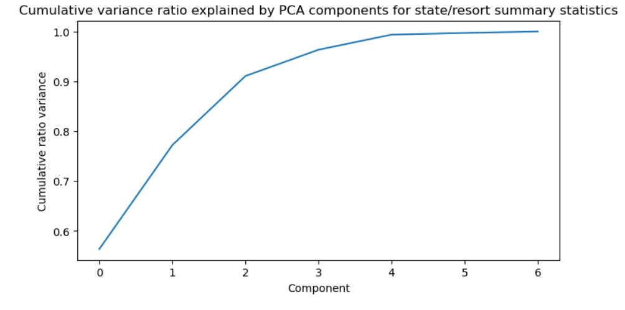
Modeling results and analysis
The first two components explain to account for over 75% of the variance, and the first four for over 95%.

Slide 4
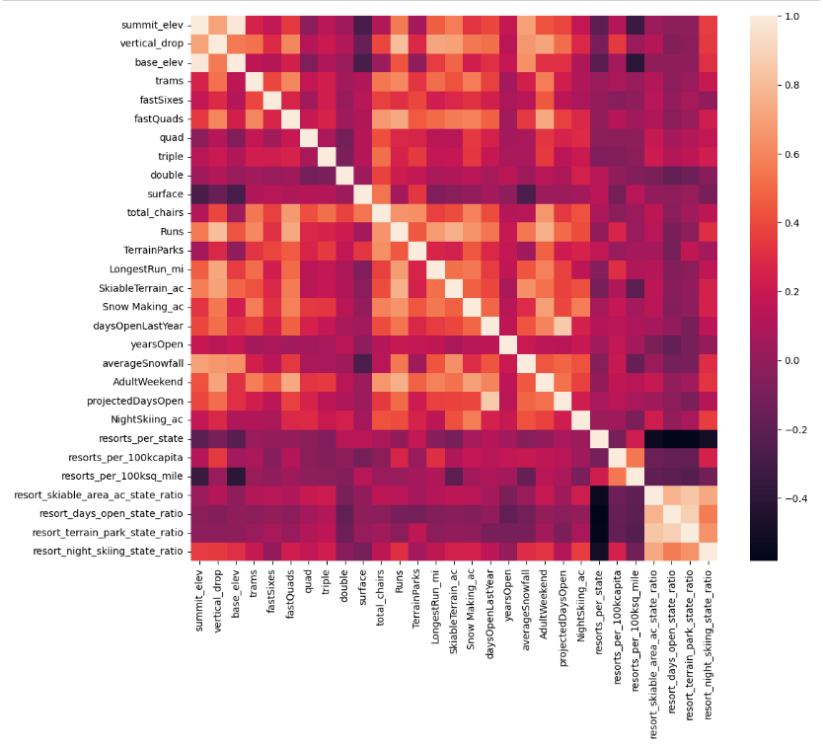

Slide 5
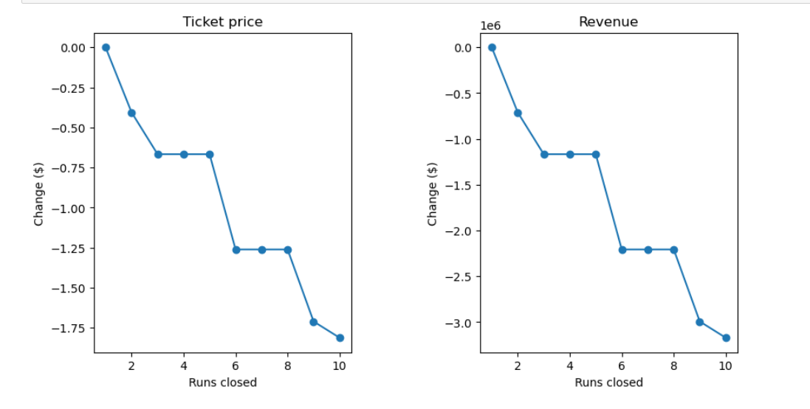
Turning attention to the target feature, AdultWeekend ticket price, we observed reasonable correlations. 'fastQuads,' 'Runs,' and 'Snow Making_ac' stood out. 'resort_night_skiing_state_ratio' was the most correlated among the new features.

Slide 6
The model says closing one run makes no difference. Closing 2 and 3 successively reduces support for ticket price and so revenue. If Big Mountain closes down 3 runs, it seems they may as well close down 4 or 5 as there's no further loss in ticket price. Increasing the closures down to 6 or more leads to a large drop.

Slide 7
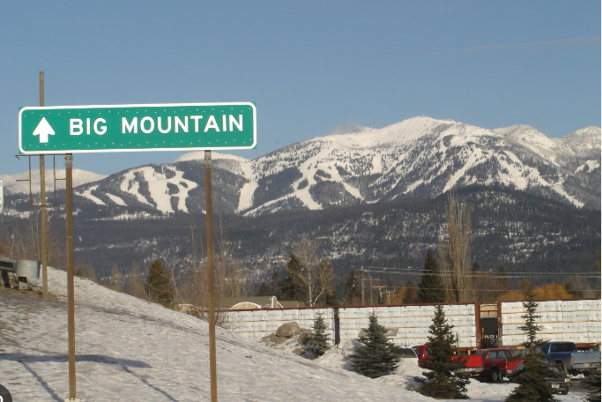
Summary and conclusion
As a result, Big Mountain Resort should increase its pricing from $81 to approximately $96

